Slide 1
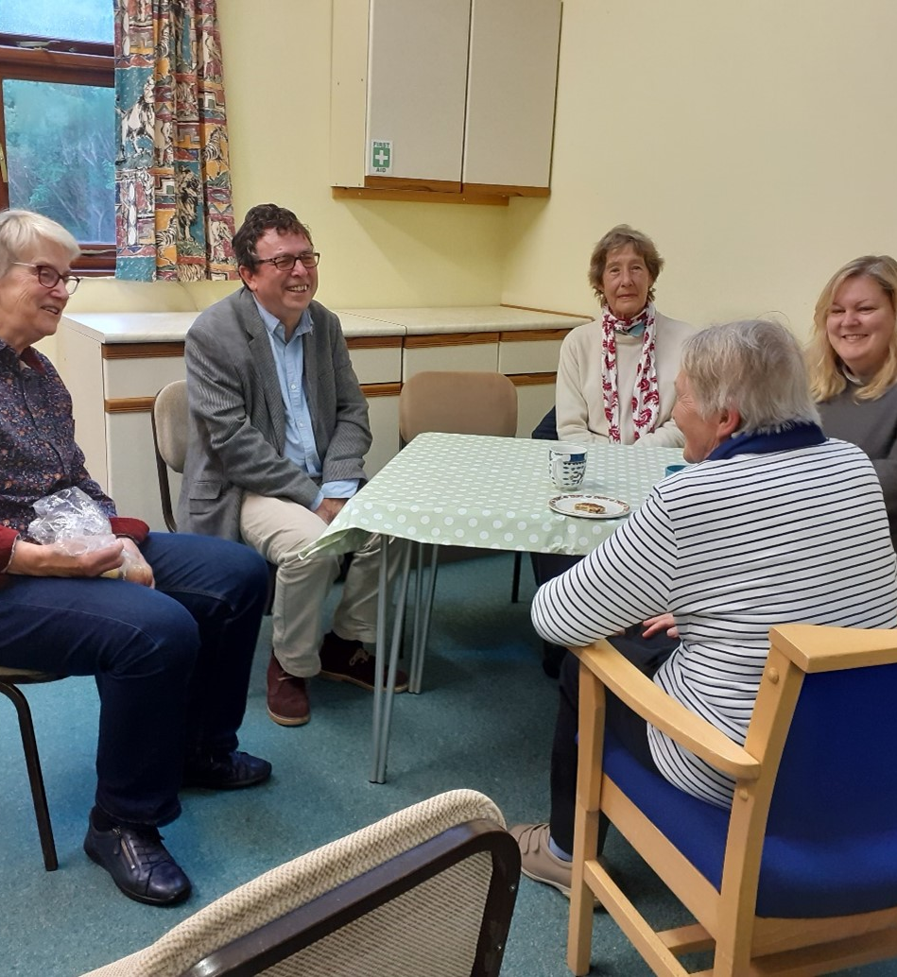
Mental Wellbeing: An Island Perspective
August 2022

Slide 3
Updating the header
To update the header and add your local Healthwatch name. Go to view > slide master > and then you can update the headers on each master slide.
Contents
Introduction 4
What we did 5 - 6
What people told us 7 – 12
Mental wellbeing grants 13
Conclusion 14
Next Steps 15
Contents
You’ll need to update the contents page manually once your document is complete.
Page grid
There is a page guide grid to help with the page layouts and alignments. To view this grid go to: View>Guides>Guides.
Be aware these guides cannot be locked and therefore you might select and move a guide rather than an object.

Slide 4
Introduction
What is Healthwatch?
Healthwatch Isle of Wight is your local health and social care champion. From Sandown to Freshwater and everywhere in between, we make sure NHS leaders and other decision makers hear your voice and use your feedback to improve care. As an independent statutory body, we have the power to make sure NHS leaders and other decision makers listen to local feedback and improve standards of care.
Local and National Context.
It has been generally accepted that during the Covid-19 pandemic, there has been a gradual increase in the prevalence of mental health conditions, primarily anxiety and depression, and the Local Government Association described this as a ‘silent pandemic’ https://local.gov.uk/mental-health-health-inequalities-and-covid-19.
The United Nations cited that in May 20, psychological distress in populations was widespread. https://www.un.org/sites/un2.un.org/files/un_policy_brief-covid_and_mental_health_final.pdf
We are aware many people have been disproportionately affected by the pandemic and many of these people will not have asked for help and so may not be known to health and social care services.
Locally, the IOW Council has signed up to the Mental Health Challenge and Councillor (Cllr) Michael Lilley is their Mental Health Champion.
In February 2021, we held a consultation to find out what health and social care priorities local people would like us to look at in more detail. Over 400 people took part and over 40% of these chose mental health as a topic of interest.

Slide 5
What We Did
In the summer of 2021, we met with the IOW Council mental health champion, Cllr Michael Lilley to discuss how we could engage with people in local communities to hear about their experiences of mental wellbeing. We were aware that some groups of people had been significantly affected by the Covid-19 pandemic and we wanted to hear about their experiences and the challenges they faced.
We made it our priority to connect with people who don’t always have a voice to ensure we could truly reflect the diversity of Isle of Wight communities.
We contacted voluntary sector groups across the Island who kindly invited us to attend their community groups and drop in sessions in December 2021 and January 2022.
You can edit this page with your own information or you can leave this as it is.
We developed a project plan and agreed that we wanted to achieve the following aims from this work:
To Identify what helps people to maintain their wellbeing
To establish if there are any gaps in community support in certain areas of the Island.
To Improve people’s access to services by bringing some information on mental health services and support groups with us on the visits.
Most importantly, we wanted to listen to people’s experiences, in a place they feel comfortable and over a cup of tea or coffee.
Who we talked to
We ensured that we covered each of the three locality areas on the Island and focused our attention on speaking to communities of interest such as unpaid carers, people with a mental health condition, veterans and people living in rural communities.

Slide 6
What We Did
In collaboration with the IOW Council mental health champion, our Healthwatch team visited nine community groups. We spoke to people individually and in groups and we also spoke to the volunteers and some paid staff who ran the community groups.
You can edit this page with your own information or you can leave this as it is.
We would like to thank all the people who took the time to share their experiences with us
We also warmly thank the voluntary sector organisations that welcomed us to their community groups, drop in sessions and coffee mornings:
Nature Therapy
Ventnor Well Being Café
Independent Arts
Carers IW
West Wight drop-in group, Totland
West Wight drop-in group, Freshwater.
IOW Prostate cancer support group
Out on an Island pop up cafe
Thank You!
During our visits we wanted to have an informal conversation with people, so our discussions were unscripted and intuitive. We reassured people that although we would be writing a report of our findings, their feedback would be anonymised and they would not be able to be identified because of their feedback
We took up to date information about mental health resources to ensure we could signpost people when appropriate.
Who we talked to
We spoke to over 130 people in December 2021 and January 2022, visiting many areas of the Island including Newport, Ventnor, West Wight and Ryde.

Slide 7
What People Told Us.
The following themes arose from our conversations with local people.
1. The importance of community spaces and faith groups.
2. The value of listening
4. The role of unpaid carers
3. The effects of bereavement
5. Physical and mental wellbeing
6. The cost of living crisis

Slide 8
The importance of community and faith groups
During the course of the Covid-19 pandemic, community, faith and voluntary sector organisations stepped up almost overnight, to ensure local people were safe and able to access the vital services they needed.
They instantly recognised the need to support people within their local communities to reduce the loneliness and isolation that the pandemic brought with it.
Community groups described how they had rallied round at the beginning of the pandemic, to identify members of the local community with particular skills, abilities and resources (including time) and had assessed the most urgent needs of local people. As well as supporting people to collect essential medication from local pharmacies, delivering food supplies and connecting people with local support groups, community group leaders also began looking at how they could reach the most vulnerable people.
People we spoke to described the difference that community groups had made to their wellbeing.
It was clear that people valued the face to face contact they received within the community groups, something they had missed during the lockdown periods.
““We’d be lost without this. I wouldn’t know where to go without this (group).”
““You get really introspective on your own and spiral into circles.”
Many of the community groups we visited, raised the importance of direct human contact and the impact this has on reducing loneliness and isolation. Shared eye contact and use of body language can directly affect the ability of people to develop meaningful relationships. and reduce anxiety.
Staff and volunteers also acknowledged the need to reach out to people who are not able to access local services, who may live alone and in isolation..
“There are lots of people who aren’t on the radar – we don’t
even know they are there, particularly older people and people
who live on their own, they just have no one.”

Slide 9
The importance of community and faith groups
“This is the only place I go to where I don’t feel threatened. Not to be judged if you walk out. We all need somebody.”
People told us that they were grateful that many community groups are free of charge as this was a contributory factor in whether or not they were able to continue to attend the group. Several people also mentioned that they appreciated the fact that they don’t have to commit to attending the group, but can drop in and out when they like.
“The great thing about this café is that you don’t have to come.”
During our visits, we spoke to over 130 people of all ages and from all walks of life. They shared their experiences of coping during the covid pandemic and described what had helped them to regain control of their lives.
“Our members are from all walks of life, showing that hard times can come upon anyone. We have ex-engineers, a retired legal expert, a health professional, a phlebotomist, a successful business owner (before mental illness destroyed their life). The list is endless, there are individuals whose lives had been damaged from the beginning and those for whom circumstances has caused them to lose their way. The one thing they all have experienced is loneliness, isolation and deep sadness.”
.
‘I would be lost without the café. On the days when I am distressed on waking- having a place to go is sometimes the only reason I get up and go out of the house. The sense of purpose (helping and chatting to other members) is so beneficial to my sense of self-worth. Plus, the help/support I receive in equal measure is priceless.”

Slide 10
The Value of Listening
People told us that they didn’t always feel listened to. One person commented that they were offered support in looking after a relative, but not the support they wanted and needed because services had not listened to what they said. Several people mentioned that they felt ignored and superfluous during the pandemic and felt as though they were just left to “get on with it” on their own.
“People need human contact. You feel so alone when you’re going through things. In lockdown I’m not even speaking to neighbours. Its so nice knowing you’re not the only one going through this.”
Many people felt very grateful that community groups were there for them, listening to them share their experiences. This was one constant in their lives.
Other people we spoke to are unable to read and write and so place more value on face to face communication.
Those people we spoke to who live alone often had no other interaction with people, other than that at their local community group.
Several people commented that health workers including GP practice staff and mental health workers did not always call them back when they said they would and this left them feeling devalued and unwilling to contact the service again.
“One of the worst things with mental health is to promise something – the worst is when they say they’ll call, and they don’t.”
“Everything is done online or on the phone now. No contact with another human being. It’s become normal now. Terrible. There needs to be more human contact to help people get on with their lives.”
“I don’t need professional help, I just need people to talk to.” “Trying to keep myself occupied.”
The recognition of being listened to is the response from another person that tells us that our feelings, actions, and intentions are meaningful.
Who we are and what we say triggers other people's response to us. That response and our connection to others remain vital to our psychological well- being

Slide 11
Bereavement
Bereavement was a theme that transgressed across all the groups of people we spoke to, affecting people of all ages, sexes, and across all areas of the Island.
Many people we spoke to had been affected by bereavement during the pandemic. The restrictions placed on visiting people in hospitals and care homes and on the arrangements for funerals, had affected people deeply and still did so.
Some people had lost several friends and relatives during covid and this impacted them emotionally and financially. One person described losing their business after a family bereavement.
One person we spoke to had set up a local bereavement group following the death of his wife several years before.
After his wife died, he felt that there must be other people in the same position as him in his local area, so he set up a group called ‘good grief’.
The group was run from his house and ran for 2 years prior to covid, with an average of 10 – 12 people attending the meetings on a regular basis.
.
Unpaid carers told us that when the person they were caring for died, they not only mourned their loss, but also mourned for their loss of purpose. After caring for someone for 24 hours a day, 7 days a week, they were left with nothing, an emptiness, a loss they could not replace.
Other people reported that the bereavement counselling service offered by Mountbatten was outstanding and allowed them to process their grief and talk to someone who was not connected to them. This service was highly valued.
Cost of Living Crisis
Even at the end of last year and the beginning of 2022, people told us that they were struggling to pay for day-to-day basic expenses.
“We’ve survived on the food bank the last few weeks. People need good cooked food to feel better. “
Anxiety about financial insecurity meant that people were unable to prioritise their own health and wellbeing
“Can’t see an end at the moment – life is so dark.” We struggle on our money.”
Several people could not see how their life could change and were constantly worried about the stability of their rental accommodation. They lived life day to day and relied on the charity of community groups for food for themselves and their families. This had a detrimental affect on their mental health.

Slide 12
This example story shows how you can lead with your impact.
The experience of unpaid carers
There are an estimated 16,000 people on the Island who provide essential care and support to their partner, child, parent, relative, friend or neighbour.
Isolation
We spoke to people who had cared for a number of people over the years from parents, siblings to husbands and wives. They had often devoted their lives over many years to caring for friends and relatives. Often, people had no family support network on the Island and felt isolated and alone.
This was exacerbated during the pandemic when social contact was restricted and services were difficult to access.
“Isolation is a biggie – covid sent lots of people over the edge.”
Access to Services
People told us they were having difficulty in accessing services. They reported particular difficulties in getting through to some GP practices and in getting an appointment for themselves or the person they cared for. They also experienced difficulties in accessing other services, such as the IOW NHS Trust memory service and community mental health services.
“No one phones to see how you are.”
People reported being referred for services. When they received no contact, they rang the service only to discover that their referral had been refused.
Others were aware that health and social care services had been instructed to restrict their activity due to the risk of Covid-19, but felt that they had been abandoned at their time of greatest need.
“People go into crisis because there is not enough support.”
Workforce shortages
Many people we spoke to were aware of the shortage of health and social care staff due to the prolific reporting of this in the media. This increased their anxiety and prompted them to be grateful for any help they were offered.
“The news worries me, the news about lack of carers”
The covid pandemic added additional complexities for those unpaid carers who also worked. Trying to maintain their employment whilst keeping the person they were caring for safe, often proved difficult and stressful.
One person reported that the care agency who supports a relative, may have to stop providing support if the person continues to work and is therefore at risk of contracting covid.

Slide 13
Mental Wellbeing Grants
Since the beginning of this year, we have been working closely with the IOW Council and Public Health, to share the anonymised experiences that people have shared with us as part of our listening tour. Councillor Karl Love recognised the value of community groups, and the role they play
in providing reliable, consistent support for people within their local community.
In response to this, Cllr Love worked with Public Health to allocate £54,000 in funding to support local voluntary and community groups in February this year..
Healthwatch Isle of Wight, Cllr Michael Lilley and representatives from Public Health, met to discuss how the funding should be allocated.
l
e response to the call for applications was amazing and really difficult to decide the final projects which had incredible innovation. The range of projects awarded covers the Island geographically and some of the most vulnerable groups to loneliness, isolation, depression, and suicide such as LGBT community, veterans and men. There were some real social entrepreneurs who were tackling the barriers to support in creative ways such as Natural Therapy with drumming in the outside environment and Dale Hiller, the pioneer behind the Veterans Hub café on the High Street in Ryde. These were real grass-roots initiatives by Islanders which show how powerful self-help and peer support is in combatting the isolation and loneliness that triggers suicidal thoughts. I the next 6 months.”
Quote from Cllr Michael Lilley
“The response to the call for applications was amazing and really difficult to decide the final projects which had incredible innovation. The range of projects awarded covers the Island geographically and some of the most vulnerable groups to loneliness, isolation, depression, and suicide such as LGBT community, veterans and men. There were some real social entrepreneurs who were tackling the barriers to support in creative ways such as Natural Therapy with drumming in the outside environment and Dale Hiller, the pioneer behind the Veterans Hub café on the High Street in Ryde. These were real grass-roots initiatives by Islanders which show how powerful self-help and peer support is in combatting the isolation and loneliness that triggers suicidal thoughts. I look forward in visiting them all over the next 6 months.”
The following groups received funding
Nature Therapy CIC
Carers IW
Men Only IOW
Community Spirited Café
The Veterans Hub
Ventnor Wellbeing Café
Brading Men’s Shed
Sensory Space
Our Place – West Wight
Tidal Family Support
Pigsty Farm
IOW Prostate Cancer Support Group
Equals IW
Cowes Men’s Shed
Wight DASH
Out on an Island
Safe Places Project

Slide 14
Conclusion
Throughout our listening tour, we were privileged to meet over 130 people who shared their experiences with us. They told us how they had lost loved ones during the pandemic and how their lives had turned upside down. They described the fear and anxiety which had enveloped their lives, with people becoming virtual recluses for fear of contracting covid and the affect this would have on their immediate families.
Many described how the pandemic had affected them financially, with some losing their businesses and others not able to continue working. Lack of affordable housing or indeed, lack of social housing, was a real concern for many and it was difficult for people to prioritise their own wellbeing when faced with being homeless and not being able to afford essential bills.
It became very evident that unpaid carers were more likely to become socially isolated during the pandemic and their responsibilities increased significantly.
Unpaid carers are the backbone of any health and social care system, but they often felt overlooked and undervalued, finding access to services difficult, including agreed respite care.
The cumulative affect of this has led to
unpaid carers becoming more fragile, less
resilient and less able to cope with the challenges
of the role they face. Unless things improve
rapidly, it is likely that more unpaid carers will
struggle to cope, leading to the need for urgent
crisis response which could have been avoided.
What also emerged however, is the extremely significant role of the voluntary sector and the way in which community groups rallied round and supported local people with a huge variety of needs. Local groups did (and often still do) support people to access free food and drinks, provide a safe space for people to meet others on a face to face basis and offer the opportunity for people to be signposted to other sources of help and support. Their services have seamlessly evolved to meet people’s needs and those of their families and neighbours.

Slide 15
Next Steps
Earlier this year, Cllr Michael Lilley published an interim report, detailing the initial themes which had arisen from our joint mental wellbeing listening tour.
This report gives a more detailed account of what people told us and the experiences they shared during our conversations with them in Dec 2021 and Jan 2022.
This however, is not the end, and we have made the following commitments:
We have been working closely with Public Health to ensure that peoples experiences are fully incorporated into the Islands Mental Health and Wellbeing Strategy.
We will visit all community groups that received mental wellbeing grants to see how people have been supported through this funding.
We will continue to work with council members to ensure people’s voices are heard. - We believe that feedback has to lead to change. Listening for listening’s sake is not enough.
We will seek to identify any local areas that require further support from the voluntary sector.
We will continue to engage with local people and a further update report will be published in Jan 2023, detailing people’s experiences relating to mental wellbeing.

Slide 16
IOW Council Cross Solent
Healthwatch Isle of Wight
Islehelp Advice Centre
County Hall
High St
Newport
PO30 1UD
www.healthwatchisleofwight.co.uk
t: 01983 608608
e: enquiries@healthwatchisleofwight.co.uk
tw: @HealthwatchIW
fb: facebook.com/HealthwatchIOW

