Slide 1
Annual report 2019-20
Guided by you

Slide 2
Delete this slide for
your digital version

Slide 3
Contents
Message from Chair 4
Our Priorities 5
About us 6
Highlights from our year 8 - 12
How we’ve made a difference 13 - 19
NHS Long Term Plan 20 – 22
Helping you find the answers 23 - 26
Our volunteers 27 - 30
Our finances 31 - 32
Our plans for next year 33 - 34
Thank you 35
Contact us 36 - 37

Slide 4
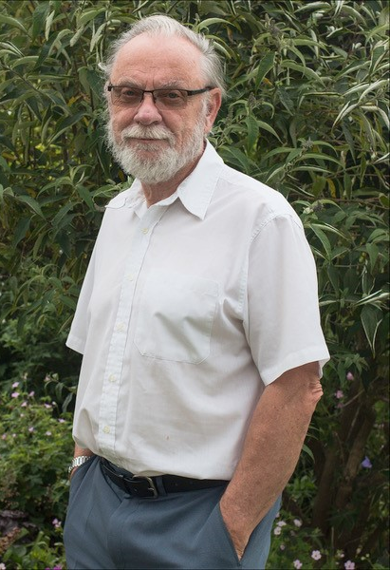
Message from our chair
Of our new priorities we were able to complete most of these, although by their nature we will continue to monitor changes and developments.
In particular I am pleased with the way the whole team has engaged with the public in ascertaining their views and needs. This has not just been reactive as we have actively encouraged groups and individuals and given them the means to voice their views.
Two very different approaches have also been developed:
In Care Homes, as a matter of policy our volunteers regularly engage with residents, to gather their views and feelings about the services they are receiving.
Working with the Isle of Wight College we seek to empower students to develop health and well-being priorities for younger people. In adopting this approach the learning will be carried forward into their careers in health and social care.
Against the background of guiding health and social care providers into making improvements locally, Healthwatch is becoming more involved in strategic service development, in particular the Long Term Plan and development of an Integrated Care System. This will have a major impact on how and where services are provided for Islanders. This work will be continuing during the coming year as we work with our colleagues in Hampshire, Portsmouth and Southampton.
As I have already indicated Covid-19 has had a major impact on the work of our team since March and will continue to do so this year. In this we have become a conduit, providing and sharing information with service providers to ensure the needs of individuals or groups of individuals are considered when decisions are taken. We are also providing and sharing information with our very active voluntary sector, whose role can not be understated.
Chris Orchin
Healthwatch Isle of Wight Chair
2019-2020 was a challenging year in many ways. It was a year of consolidation and developing new priorities based upon what you were telling us, details of which are contained in the following pages. What was not planned was COVID-19 and that had a major impact on the work we were doing and created a new focus for the team.

Slide 5
Our priorities
Last year 849 people told us about the improvements they would like to see health and social care services make in 2019-20. These were our six priorities for the year ahead based on what you told us.
● Support for Veterans ● Engaging with people in residential care
and nursing homes
● Adult Mental Health Services ● Supporting the development of an IOW
(inpatient care) Dementia Strategy
● Looking at people’s experiences of ● Working with IOW College students to
extended access for primary care develop peer led research projects
The Isle of Wight Council is proud to commission Healthwatch Isle of Wight who provide an effective, assertive and independent voice for island residents about their experiences of the island’s health and care services. The team at Healthwatch Isle of Wight continue to work hard to identify and challenge health and social care inequalities, make positive suggestions for improvement and champion the use of public feedback to shape and improve the quality of health and care delivered by the NHS, the Council and care providers on the Isle of Wight.
(IOW Council statement)

Slide 6
About us
Here to make care better
The network’s collaborative effort around the NHS Long Term Plan shows the power of the Healthwatch network in giving people that find it hardest to be heard a chance to speak up. The #WhatWouldYouDo campaign saw national movement, engaging with people all over the country to see how the Long Term Plan should be implemented locally. Thanks to the thousands of views shared with Healthwatch we were also able to highlight the issue of patient transport not being included in the NHS Long Term Plan review – sparking a national review of patient transport from NHS England.
We simply could not do this without the dedicated work and efforts from our staff and volunteers and, of course, we couldn’t have done it without you. Whether it’s working with your local Healthwatch to raise awareness of local issues, or sharing your views and experiences, I’d like to thank you all. It’s important that services continue to listen, so please do keep talking to your local Healthwatch. Let’s strive to make the NHS and social care services the best that they can be.
I’ve now been Chair of Healthwatch England for over a year and I’m extremely proud to see it go from strength to strength, highlighting the importance of listening to people’s views to decision makers at a national and local level.
Sir Robert Francis, Healthwatch England Chair

Slide 7
Our vision is simple
Health and care that works for you. People want health and social care support that works – helping them to stay well, get the best out of services and manage any conditions they face.
Our purpose
To find out what matters to you and to help make sure your views shape the support you need.
Our approach
People’s views come first – especially those who find it hardest to be heard. We champion what matters to you and work with others to find solutions. We are independent and committed to making the biggest difference to you.
How we find out what matters to you
People are at the heart of everything we do. Our staff and volunteers identify what matters most to people by:
Visiting services to see how they work
Running surveys and focus groups
Going out in the community and working with other organisations
Find out more about us and the work we do
Website: www.healthwatchisleofwight.co.uk
Twitter: @HealthwatchIW
Facebook: @HealthwatchIOW

Slide 8
Highlights from our year
Find out about our resources and the way we have engaged and supported more people in 2019-20.

Slide 9
Health and care that works for you
22 volunteers
helping to carry out our work. In total, they gave up 412 hours
We employed
4 staff
45% of whom are full time equivalent, which is the same as the previous year.
We received
£147,000 in funding
from our local authority in 2019-20, which is the same as the previous year.
Providing support
849 people
shared their health and social care story with us this year.
37 Residential homes
We visited 25 care homes and 12 nursing homes and spoke to 72 residents. We made 57 recommendations for improvement.
Reaching out
Social media
5,235 page views on our website, with 1759 new users.
659 people follow us on Facebook.
Making a difference to care
We published
7 reports
about the improvements people would like to see with their health and social care, and from this, we made 26 recommendations for improvement.

Slide 10
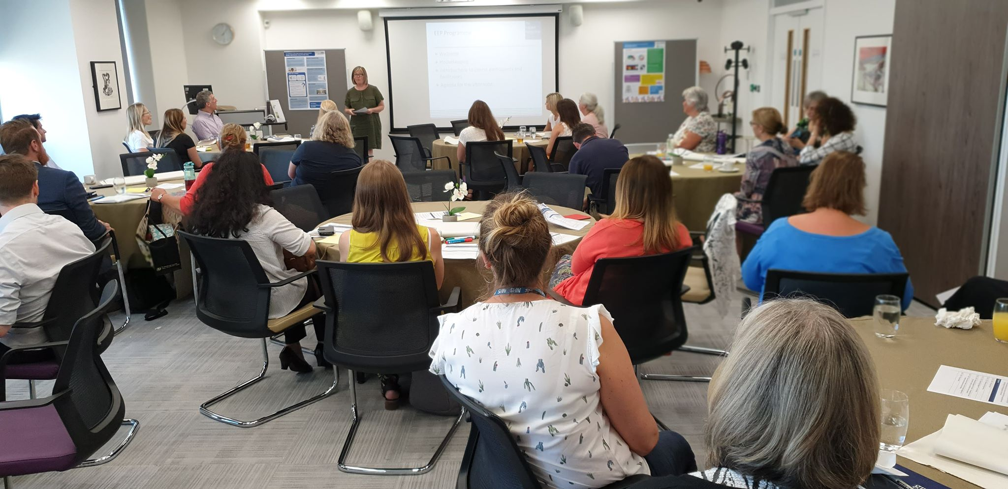
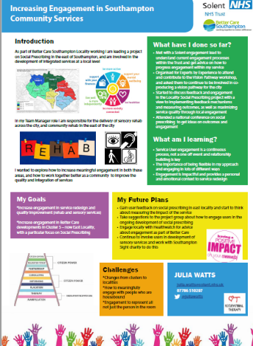
Hampshire and Isle of Wight Empowering Engagement Programme and Showcase Event
Hampshire and IOW Empowering Engagement Programme
The Hampshire and Isle of Wight Empowering Engagement Programme is led by Wessex Voices, which is a partnership between the five local Healthwatch in Wessex and NHS England.
In 2019, the Empowering Engagement programme was delivered across Hampshire and the Isle of Wight, where healthcare staff were supported to ensure that patient and public involvement is central to the commissioning and delivery of all healthcare services. The programme ended on the 23rd July 2019 with a showcase event held at Solent University, Southampton.
Thirty-six colleagues from across health and social care came to hear about the learning from this innovative patient and public involvement (PPI) development programme, delivered by Wessex Voices, Paul England, Healthwatch Isle of Wight and other external subject experts.
A link to all the posters, which provides more details about the projects and the learning can be found here.
Here is some feedback about the programme:
I am passionate about PPI … but recognise we are at the start of the journey ...
… We say we are patient centred but are we? … The EEP has reprogrammed me to be …

Slide 11
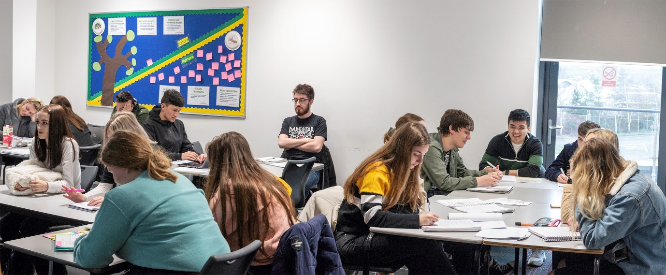
Engaging with Young People
IOW College Health and Social Care Students
For the past 12 months, Healthwatch Isle of Wight has worked in partnership with the Health and Social Care team at the IOW College.
We regularly visited the students and provided support for their research projects. We supported them to learn how health and social care systems work and how they are funded and held a focus group with them to identify the health and social care topics that were most important to them.
The students then used these topics as a focus for their research projects.
Their top five priorities are:
Mental health
Healthy lifestyles
Eating disorders
Rights and access to healthcare
Body image
We delivered a teaching session on the use of surveys and gave students a ‘Top 10 Tips for using questionnaires’ to support their research.
The student’s research projects will be presented to the IOW Health and Wellbeing Board.

Slide 12
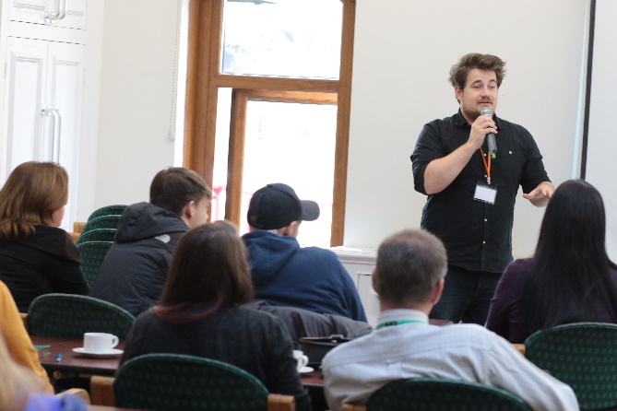
Isle of Wight Neurodiversity Conference.
In November 2019, we were proud to support the first Isle of Wight Neurodiversity Conference.
This was the innovation of a group of Island people, who were concerned about the lack of training and events relating to neurodiversity on the Island.
Neurodiversity 2019 was a free conference, packed with fantastic national and international speakers, aimed at Island neurodivergent people and the people who live and work with them.
Around a third of the speakers were neurodiverse themselves, a further third were parents or carers of neurodiverse people and all of the speakers were leaders within their field.
The conference quickly sold out and was hugely successful thanks to the dedication and commitment of those initial group of friends.
Speakers included Chris Packham, Yvonne Newbold, Nathan Keates, Trude Stenhammer, Dr Beatriz Lopez, Tigger Pritchard and Professor Jeremy Turk.
Speakers and organisers of the conference, Nov 2019

Slide 13
How we’ve made a difference

Slide 14
Healthwatch Covid Intelligence Reports
What we did.
The way health and social care services operate has been affected by coronavirus (COVID-19), with non-urgent treatment postponed, face-to-face appointments reduced and care homes and services limiting public access.
At Healthwatch, we had to rapidly change our work, focusing more on sharing important information with the public via our information, advice and signposting service.
We knew that now, more than ever, it was essential for service providers and commissioners to understand the impact that Covid is having on local people.
We quickly began producing two weekly intelligence reports, which were shared will IOW and Hampshire system leaders. This will ensure that any changes to services, take account of local people.
Share your views with us
If you have a query about a health and social care service, or need help with where you can go to access further support, get in touch. Don’t struggle alone. Healthwatch is here for you.
Website: www.healthwatchisleofwight.co.uk
Telephone: 01983 608608
Email: enquiries@healthwatchisleofwight.co.uk

Slide 15
Speaking up about your experiences of health and social care services is the first step to change. Take a look at how your views have helped make a difference to the care and support people receive on the Isle of Wight.
A&E: Helping people have a better experience
People told us that they were not getting food and drink when they were in the A&E department, even if they were there for long periods of time. Medication was not always given and privacy and dignity was not always respected.
After consulting with patients, A&E staff have purchased porridge in pots. Breakfast is offered to all patients at 8.00am and meals are prioritised. Doctors have been told to inform nurses if a patient has been prescribed high priority medication.
Thanks to people speaking up, there is now a dedicated cubicle within the A&E department which has been freed up. This now enables people to receive personal care or medical treatment in a private environment, when the department is busy.
‘It looked like a war zone with beds in corridors, I had to be examined in the middle with everyone watching’
‘I waited 4 hours for an ambulance and a further three and a bit hours left unattended on a trolley in the A&E department.’
As a result of highlighting these concerns to the IOW NHS Trust, substantial improvements have been made to the department to improve the experience of patients.

Slide 16
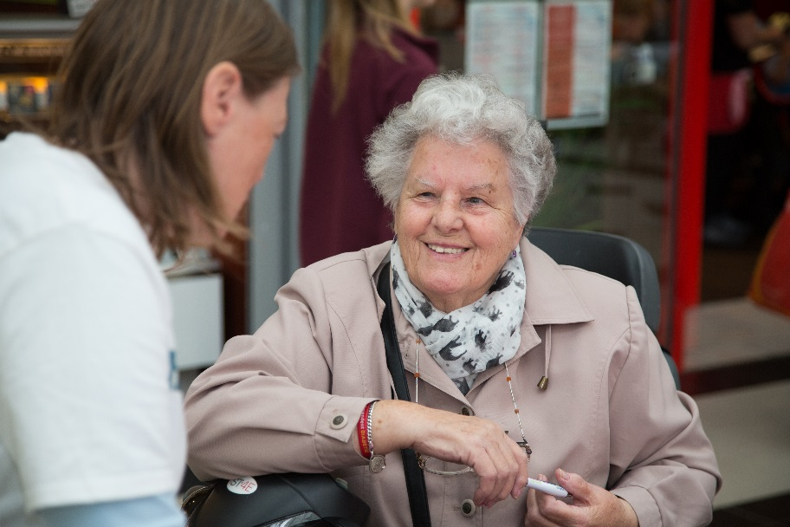
Improving Quality in Residential Homes
Care Homes: Experts by Experience Project
For the past two years, Healthwatch Isle of Wight has worked in partnership with the IOW Joint Quality Team to support with the regular quality monitoring visits to IOW residential care and nursing homes.
We provide a team of ‘Experts by Experience’ who visit the residential homes to speak to residents and their relatives. The experts also observe practices within the home and report back to the care home manager.
During the past 12 months, our ‘Experts by Experience’ have spent 84 hours
visiting 24 care homes, 12 nursing homes and 3 residential homes for adults with a learning disability.
During the visits, the Experts spoke to 72 residents, 76 members of staff, 11 family members and 30 managers.
57 Recommendations for improvements were made to the care home managers
Good practice was highlighted to the manager and shared with commissioners:
A relative specifically mentioned the maintenance man who has collected them from their home to enable them to join in with the Christmas dinner at Sandown Nursing Home.
Share your views with us
If you have a query about a health and social care service, or need help with where you can go to access further support, get in touch. Don’t struggle alone. Healthwatch is here for you.
Website: www.healthwatchisleofwight.co.uk
Telephone: 01983 608608
Email: enquiries@healthwatchisleofwight.co.uk

Slide 17
Promoting Safeguarding Within the Voluntary Sector
IOW Local Safeguarding Adults Board: Voluntary Sector Safeguarding Project
We were commissioned by the IOW Local Safeguarding Adults Board to work with People Matter IW to promote Safeguarding and Making Safeguarding Personal principles within the IOW community and voluntary sector.
We began by asking voluntary sector partners to complete our safeguarding survey. 34 voluntary and community sector organisations completed the survey, giving us valuable insight into their knowledge of safeguarding and the barriers they experience when managing safeguarding concerns within their organisations.
In response to the feedback received within the survey, we developed a safeguarding training package with support from the IOW Council safeguarding team.
We delivered training sessions to 63 staff and volunteers from 7 voluntary sector organisations to update their
knowledge and skills and remove some of the barriers they face from reporting safeguarding concerns.
There are further plans for Healthwatch to establish safeguarding ‘Champions’ with the voluntary sector to provide mentoring support to colleague and to provide a direct link with the IOW Council safeguarding team.
Feedback from the training was positive:
“A good session provoking much thought. Thank you.”
“Very interesting and informative.”
“ I have previously done level 3 safeguarding, but this was good as a reminder - easy to forget certain aspects.”
“We had some very helpful discussions.”

Slide 18
Inpatient Mental Health services
In 2019, our Enter and View representatives visited every inpatient mental health ward at the IOW NHS Trust as well as Woodlands, the rehabilitation ward.
We particularly focused on the following:
The environment
Provision of activities
Staff interaction
General observations
We also concentrated on specific areas of concern raised by the Care Quality Commission within their inspection of the IOW NHS Trust during January/February 2018.
An Enter and View report was published for each area of the Trust we visited and in December 2019, we published the Overarching Inpatient Mental Health report.
Overall, we found that the staff we spoke to were friendly and relaxed and the wards were clean and tidy.
However, activities were not always person-centred and people were not always able to take their agreed ‘home leave.
We made 14 recommendations to the IOW NHS Trust
IOW NHS Trust response:
‘I have discussed the enter and view reports with my colleagues from the wards. We are pleased to read the positive feedback about services, and we do accept all of the recommendations.
We always welcome feedback about services that enables us to improve, and we are grateful to you and your team for these reports.’
The full response can been found on the Healthwatch Isle of Wight website:
www.healthwatchisleofwight.co.uk
Patients told us that they wanted staff to talk to them more often and they wanted the ward to look more “homely”

Slide 19
Supporting GP Patient Participation Groups
This has been another busy year for us and has included the following work:
Our focus has been on supporting PPG’s with their recruitment of patients and we developed a toolkit to help GP practices with this.
We supported GP practices to recruit independent chairs, rather than a member of the surgery staff and there are now at least 3 more independent chairs.
We host a ‘Chairs meeting’ which is attended, quarterly, by all the (independent) chairs across the island to pool ideas, concerns and resources.
We supported PPG’s to create action plans for the forthcoming months.
We put together a standard 5 question
survey which could be utilised by all
PPGs, gauging how the patients felt
about surgery and online appointments. This was used to great success, particularly when surgeries were merging. They were able to gather a lot of responses and it proved a good introduction to the PPG for the patients.
We supported one PPG to successfully bid for a grant from the Communities against Cancer project and we also put together a newsletter which they could use as a template for future editions.

Slide 20
Long Term Plan
#WhatWouldYouDo

Slide 21
Highlights
More than 700 people shared their views across Hampshire and the Isle of Wight.
Our network held 8 focus groups
reaching different communities our region.
Healthwatch
attended 15 Community events in partnership with local Colleges, Age UK, MENCAP, No Limits, PRISM and other voluntary sector organisations.
NHS Long Term Plan
Following a commitment from the Government to increase investment in the NHS, the NHS published the ‘Long Term Plan’ in January 2019, setting out its’ key ambitions over the next 10 years. Healthwatch launched a countrywide campaign to give people a say in how the plan should be implemented in their communities.
Here’s a summary of our work and what we found:
What do people want?
Working with local Healthwatch in Hampshire, Portsmouth and Southampton, we asked people #WhatWouldYouDo to
improve the NHS locally. The top issues that people told us they wanted services to focus on is:
People want to be more involved in their care, to be listened to by professionals and to have their time valued.
People want easy and quick access to health care when they need it
People want to know their information is secure, but they also want better sharing of information between services, specialities and professionals

Slide 22
Our Long Term Plan report contained an analysis of the LTP survey results and solutions were developed in relation to the issues raised by survey participants.
This report was
presented to the Hampshire & IOW STP for comment.
Full details of the report and the response from the HIOW STP can be found here:
https://www.healthwatchisleofwight.co.uk/report/2020-06-24/hampshire-and-isle-wight-long-term-plan-report
Hampshire & IOW Sustainability Transformation Partnership Response:
“We are extremely grateful to the four Healthwatch in Hampshire and the Isle of Wight for the work they have done to seek the views of local people on some of the key themes in the Long Term Plan. It is essential that the views and experiences of local people are at the heart of our plans, driving forward the changes needed to improve local services and we would like to thank everyone who took part.
This report makes an important contribution to the engagement work which has already taken place across Hampshire and the Isle of Wight. It provides us with insight into the views of local people on staying well, using technology to support health and the ways in which they would like us to personalise their care.
We need to keep challenging the traditional way in which we have worked and move to a position where people and communities are in control of their health and wellbeing, with the responsive services to support them.”

Slide 23
Helping you find the answers

Slide 24
Finding the right service can be worrying and stressful. Healthwatch plays an important role in helping people to get the information they need to take control of their health and care and find services that will provide them with the right support.
This year we helped people get the advice and information they need by:
Providing advice and information articles on our website.
Answering people’s queries about services over the phone, by email, or online.
Talking to people at community events.
Promoting services and information that can help people on our social media.
Here are some of the areas that people asked about.

Slide 25
Case study: Improving access
to primary care
Paul was unable to access his GP surgery due to physical mobility problems. This had led to him and his wife not being able to see their GP for 18 months. He had tried registering with another surgery but had been unsuccessful. We contacted the IOW CCG and spoke to the practice manager at a neighbouring GP practice and received the following feedback from Paul:
“I have just had a telephone call from (practice manager) to say that the Practice is willing to accept my wife and me as new patients. This is the best piece of news we have had in a considerable while. We are so very grateful to you, for making this happen. The sun is shining here, both literally and metaphorically, and everything seems brighter”.
“We were delighted that Paul and his wife were finally able to register with a new GP surgery which they could access with ease”
Joanna Smith, Manager, Healthwatch Isle of Wight.

Slide 26
GP IT issue resolved:
Following the merger of 2 GP practices, we were alerted by members of the public that their text appointments were directing them to the wrong surgery. We contacted the practice manager to make them aware of the problem and they discovered that they had an IT issue which they were able to resolve.
Poor standards in care home:
Ben’s wife has dementia and lives in a care home. Ben was very concerned about the quality of care at the home and infection control procedures. He was reluctant to make a complaint in case his wife’s care was compromised as a result. We discussed options with him and gave him details of the standards he should be able to expect in a care home. We supported him to contact the local safeguarding team, the Quality team and the Care Quality Commission.
Access to medical records achieved:
Simon’s wife had just moved into a care home and he had been refused access to her medical records by the GP practice, despite him having Power of Attorney for finance.
We contacted the GP practice on his behalf and within several days, he had received the medical records he had requested.
Contact us to get the information you need
If you have a query about a health or social care service, or need help with where you can go to access further support, get in touch. Don’t struggle alone. Healthwatch is here for you.
Website: www.healthwatchisleofwight.co.uk
Telephone: 01983 608608
Email: healthwatchisleofwight@iwcab.org.uk

Slide 27
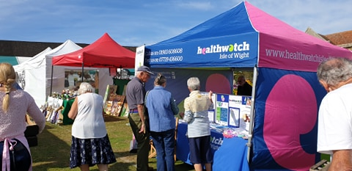
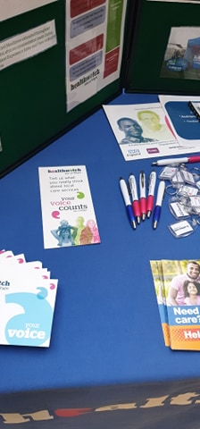
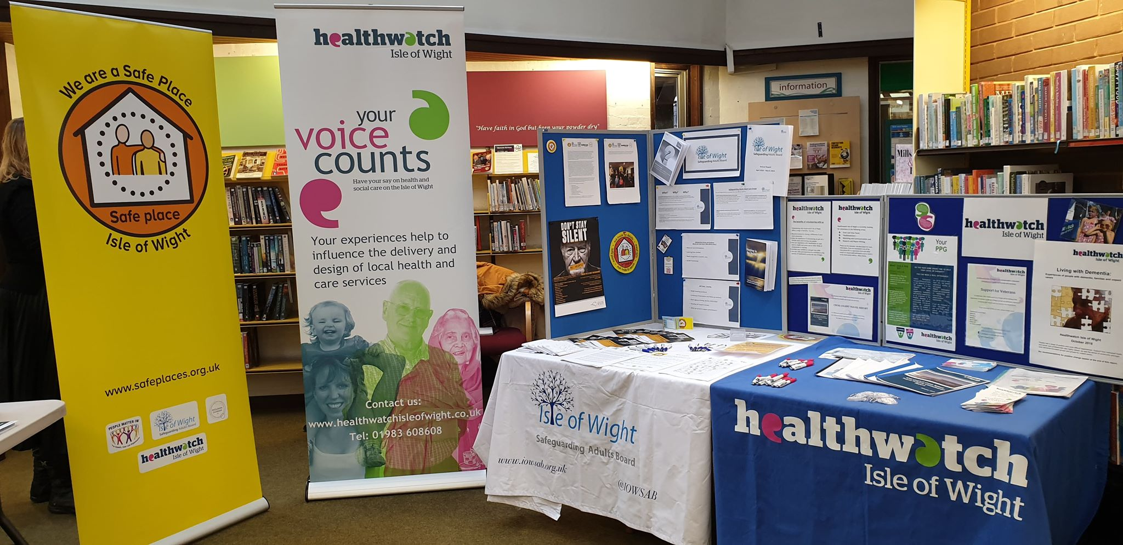
Volunteers

Slide 28
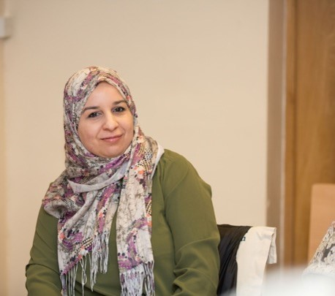
At Healthwatch Isle of Wight we are supported by 22 volunteers to help us find out what people think is working, and what people would like to improve, to services in their communities.
This year our volunteers:
Raised awareness of the work we do at events, in the community and with health and care services.
Visited services to make sure they are providing people with the right support.
Helped support our day-to-day running.
Listened to people’s experiences to help us know which areas we need to focus on.
Volunteers support patients to have their say
Thanks to the hard work of a group of volunteers, people on the Isle of Wight were able to have their say prior to the Care Quality Commission’s inspection of the IOW NHS Trust.
Our volunteers supported an event at The Riverside in May 2019 at the request of the Care Quality Commission hospital inspection team.
Our volunteers supported local people to have their say about the following topics:
Care at weekends and at night
Communication and information about treatment
Levels of kindness and professionalism of staff
Prescriptions
Privacy and dignity on the wards
The Care Quality Commission were due to inspect the IOW NHS Trust in May and June 2019 and wanted to hear from local
people prior to their visits.
Two CQC inspectors were present on the day along with Healthwatch volunteers to ensure that people were able to share their experience of St Mary’s hospital.
With our volunteers’ help, we’re keeping an eye on what people think of local health services and working with those in charge to make sure people’s views inform changes.
Volunteer with us
Are you feeling inspired? We are always on the lookout for new volunteers. If you are interested in volunteering, please get in touch at Healthwatch Isle of Wight.
Website: www.healthwatchisleofwight.co.uk
Telephone: 01983 608608
Email: healthwatchisleofwight@iwcab.org.uk

Slide 29
Our volunteers
We could not do what we do without the support of our amazing volunteers. Meet some of the team and hear what they get up to.
Margaret
“I have always found the Healthwatch team friendly and the monthly meetings interesting with group discussions and plans for the future. I had registered nurse experience and I had also been a patient following major surgery.
My first enter and view visit was a little daunting but as I visited more places my confidence increased and I was able to enjoy connecting with staff and clients enabling me to complete my visits and report back my findings.
I enjoy volunteering with Healthwatch and it’s a way clients and relatives in residential homes and hospitals can be seen and heard and their views reported.”
Maurice
“The value of Heathwatch, is that I can use some of my past experience to make a positive difference for people using health and social care services.”
Our volunteers participate in a variety of roles including Enter and View visits, mystery shopping, research, project development and community engagement

Slide 30
Healthwatch Isle of Wight is here to ensure that the voice of local people is heard by health and social care providers and commissioners.

Slide 31
Finances

Slide 32
We are funded by our local authority under the Health and Social Care Act (2012). In 2019-20 we spent 151,461.

Slide 33
Our plans for next year

Slide 34
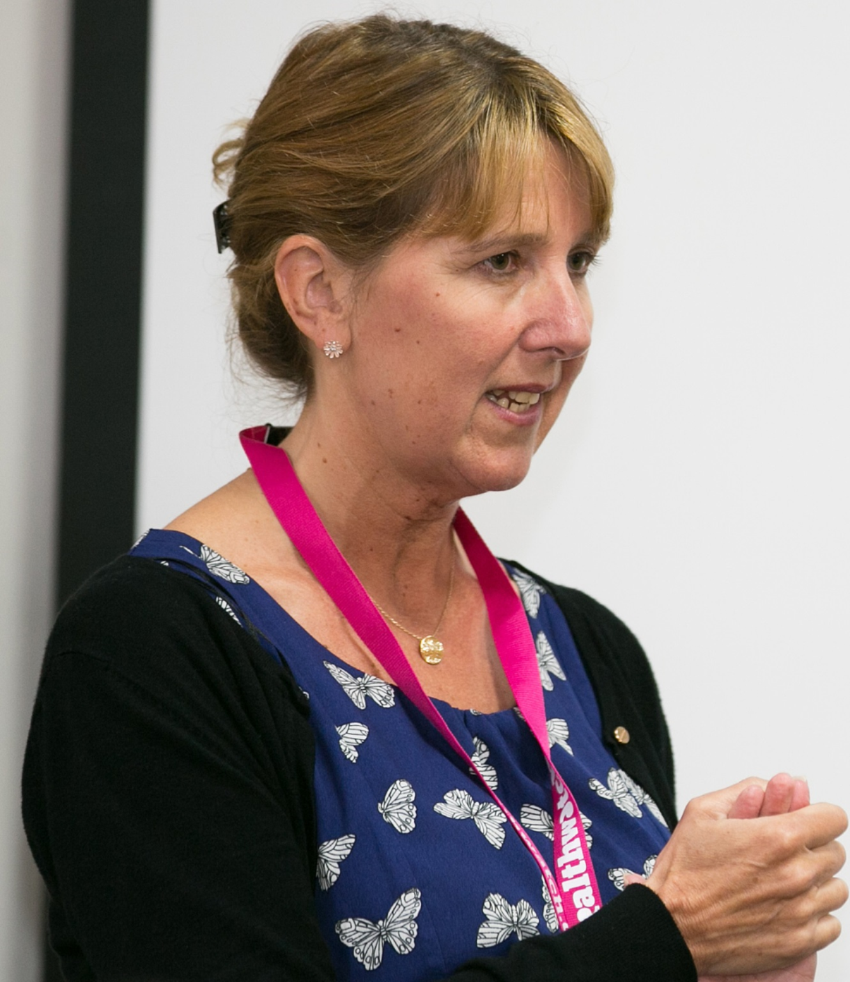
Message from Healthwatch Isle of Wight Manager:
The past year and in particular the effect of Covid-19, has led to a huge change in focus for the staff team and volunteers of Healthwatch Isle of Wight as well as every other Isle of Wight resident. As people have had to come to terms with the loss and changes associated with a global pandemic, the Healthwatch team have been continuing their work, ensuring the voice of the people is not forgotten in the midst of the changing health and social care landscape.
We have been championing the voice of the people, particularly those whose voice is not often heard and have been strongly encouraging services to communicate more quickly and widely with the Isle of Wight population.
We are blessed with a prolific and adaptable voluntary sector community which has led the movement on the Island to support those people who have been unable to go out to get their shopping, medication and other essential supplies. We would like to take this opportunity to thank those volunteers who have worked tirelessly and without complaint to ensure that friends, neighbours and all in the local community have been supported and protected.
Looking ahead
We will be working closely with system partners within the Hampshire & IOW Integrated Care Partnership and more
locally, with the IOW Council, the IOW Clinical Commissioning Group and the IOW NHS Trust to ensure that the voice of local people is heard.
We will continue to work tirelessly to promote better mental health services which are there when people need them. We would like to see a fully integrated suicide prevention plan, adopting a zero suicide approach and with an acknowledgement of the most important role that the voluntary sector play in this.
Joanna Smith, Manager, Healthwatch Isle of Wight
“Thank you to all our wonderful volunteers and to all the people of the Isle of Wight who have worked with us this year to make a difference.”

Slide 35
Thank you
Thank you to everyone that is helping us put people at the heart of social care, including:
Members of the public who shared their views and experience with us.
All of our amazing staff and volunteers.
The voluntary organisations that have contributed to our work including:
Community Action IW
Citizens Advice IW
The Advocacy People
People Matter IW
Alzheimers Café
Veterans Outreach Support

Slide 36
Contact us
Healthwatch Isle of Wight
Riverside
The Quay
Newport
Isle of Wight
PO30 2QR
Contact number: 01983 608608
Email address: healthwatchisleofwight@iwcab.org.uk
Facebook: @HealthwatchIOW
Twitter: @HealthwatchIW
Website: www.healthwatchisleofwight.co.uk
Healthwatch Isle of Wight
Riverside
The Quay
Newport
Isle of Wight
PO30 2QR
Contact number: 01983 608608 Email address: healthwatchisleofwight@iwcab.org.uk
We confirm that we are using the Healthwatch Trademark (which covers the logo and Healthwatch brand) when undertaking work on our statutory activities as covered by the licence agreement.
If you need this in an alternative format please contact us.
© Copyright Healthwatch Isle of Wight 2020

Slide 37
Healthwatch Isle of Wight
Riverside
The Quay
Newport Isle of Wight
PO30 2QR
www.healthwatchisleofwight.co.uk
t: 01983 608608
e: healthwatchisleofwight@iwcab.org.uk
@HealthwatchIW
Facebook.com/HealthwatchIOW

